Slide 1
11 . Image Smoothing Using Wavelet Transform
Mundre Sthavir Dharmpal 200050080
Harshvardhan Ahirwar 200050051
Vajrala Sahithi Reddy 200050149

Slide 2
Introduction
An image is often corrupted by noise in its acquisition and transmission.
In this assignment we use wavelet transform in connection with threshold functions for removing noise.
We have implemented 3 threshold methods Universal thresholding , Visu Shrink and Bayes Shrink for thresholding wavelet coefficients.

Slide 3
Algorithm
Get the color input image as a matrix.
Convert image from RGB to YCrCb.
Apply wavelet transform to the Y channel.
Threshold the detail coefficients LL using a suitable threshold function.
Apply inverse wavelet transform on the threshold coefficients to get denoised Y channel.
Reconstruct the image with denoised Y channel and the original Cr and Cb channels.
Convert the denoised image to RGB.

Slide 4
Why YCrCb
Wavelet Thresholding in RBG bands sometimes thresholds the color details with distorts colours in the image.
In YCrCb channels the colour information is only in the Cr and Cb channels so, thresholding the Y channel does not affect colour details.

Slide 5
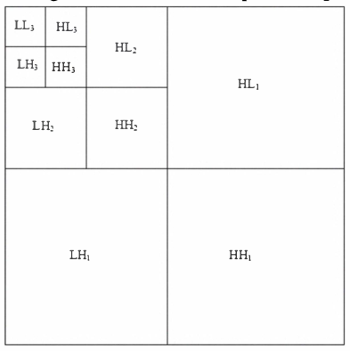
2D Wavelet Transform
2D wavelet transform divides the image into HH,HL,LH,LL subbands.
The HH band contain the diagonal details , HL band contains the horizontal details , LH band contains the vertical features.
The LL band is the low resolution residual and can be split further at higher levels of decomposition.
The detail subbands (HH,HL,LH) are thresholded to denoise the images.

Slide 6
Thresholding Methods

Slide 7
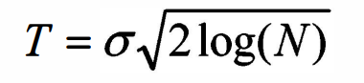
Universal Threshold
N is the signal length and σ is the noise variance.
The wavelet coefficient is threshold using T with hard/soft mode of thresholding.
It is useful for obtain a starting value when nothing is known of the signal condition.

Slide 8
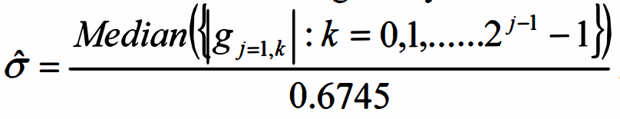
Visu Shrink
It uses a threshold value t that is proportional to the standard deviation of the noise.
It estimates 𝞼 using the above expression where g_{j,k} are the detail coefficients.
VisuShrink follows the global thresholding scheme where there is a single value of threshold applied globally to all the wavelet coefficients
It can only deal with additive noise and thus fails to denoise speckle noise.

Slide 9
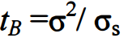
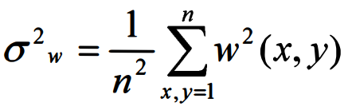
Bayes Shrink
The goal of this method is to minimize the Bayesian risk.
It uses soft thresholding and is subband-dependent, which means that thresholding is done at each band of resolution in the wavelet decomposition.
The Bayes Threshold is given by
To Calculate 𝞼_{s} we first calculate 𝞼_{w} the variance in input signal as

Slide 10
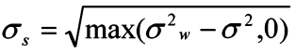
Bayes Shrink
𝞼_{w} is the variance of 0-mean detail array.
Finally 𝞼_{s} is calculated as
Bayes threshold is calculated using 𝞼_{s} and 𝞼 . Using this threshold, the wavelet coefficients are threshold at each band.

Slide 11
Results

Slide 12
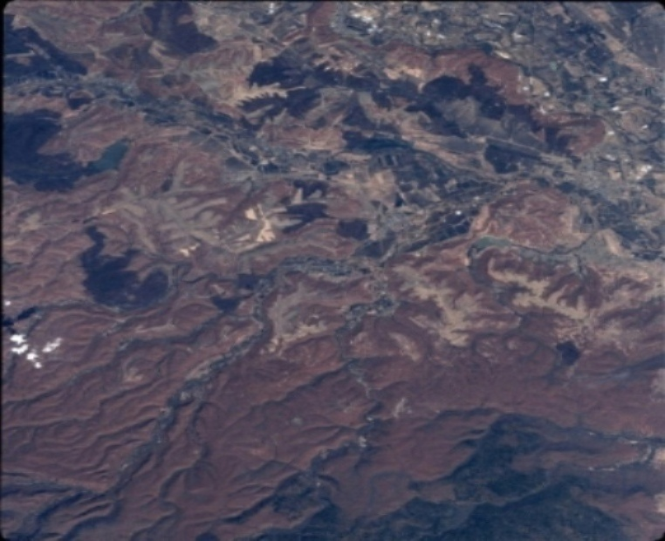

Sample Image 1
Original Satellite image
Added gaussian noise

Slide 13


Denoised images
Universal Threshold with sigma = 2
Visu Shrink

Slide 14

Denoised images
Bayes Shrink

Slide 15
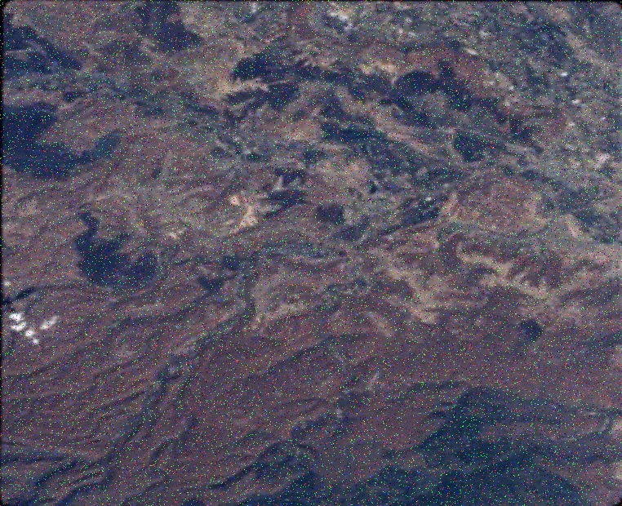
Sample Image 2
Original Satellite image
Salt and pepper noise

Slide 16


Denoised images
Universal Threshold with sigma = 10
Visu Shrink

Slide 17

Denoised images
Bayes Shrink

Slide 18
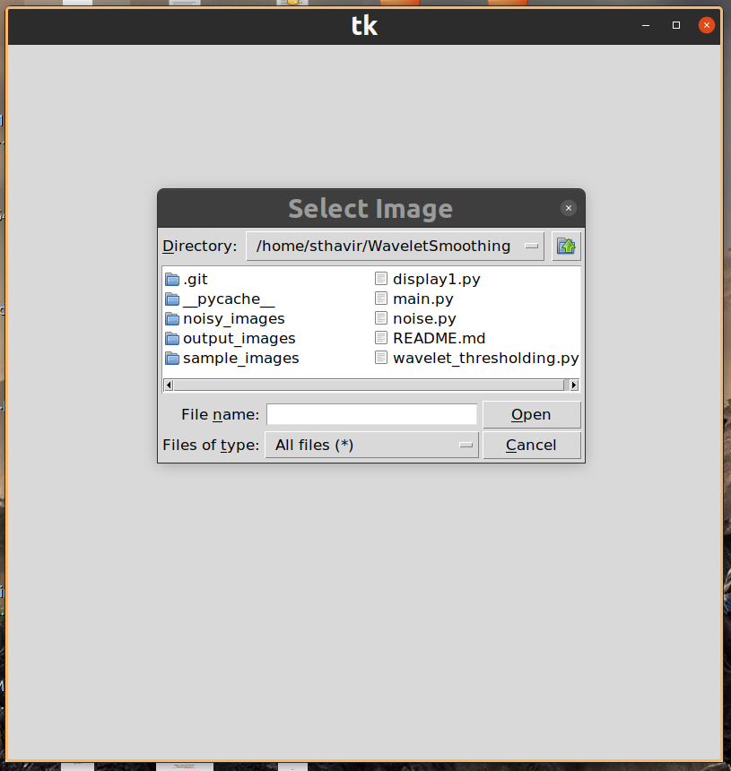
GUI
Bayes Shrink

